Slide 1

S E V E N T H A N N U A L

Slide 2
THANK YOU
for all your years of service!

Slide 3
Longevity Awards – 2 years
Grandview Terrace
Alexia Demarco
Amy Dekarske
Andrew Lessard
Charles Kerby
Dennis Vanhoose
Dominick Accardi
Emily-Ann Vanhoose
Hazel Hall
Karen Mead
Kristine Housley
Linda Marin
Linda Moore
Luma Elias
Mary Gustin
Natasha Velder
Ofelia Lopez
Patricia Cole
Ruth Doyle
Srinivasa Madala
Tina Parra

Slide 4
Longevity Awards – 2 years
La Loma Village
Adina Rivas
Alberto Gonzalez
Ashlyn Glathar
Barbara Spayde
Bellalyn Malbas
Catalina Garrett
Dalton Orick
Destinee Marshall
Susan Bibbs
Fatima Herrera
Irene Solis
Jacklyn Gonzalez
Jennifer Ortiz Roman
Julie Gaytan
Kaitlin Flowers
Margarita Macias Mendiola
Morgan Cleveland
Rachel Goodwin
Rafael Valencia
Sara Haile
Socorro Navarro

Slide 5
Longevity Awards – 2 years
The Colonnade
Charles Hoberg
Chris De La Cruz
Edgardo Lopez
Jaysey Lozada
Kaitlyn Staley
Maria Del Rocio Rodriguez
Randle Nachtigall
Trevor Granger
Victor Fraire
Victoria Thompson

Slide 6
Longevity Awards – 2 years
Administration
Ashley Durham
Claudia Vazquez
Corazon Musni
Esmeralda Chavez
Gemma Carter
Ivan Preciado
Maria Acosta
Mary Majko
Nayla Molina Sandoval
Rosanna Guevara
Rose del Rosario

Slide 7
Longevity Awards – 5 years
Grandview Terrace
Marissa Bennett
Barbara Day
Shaliza Dookie
Maria Garcia
Lorna Klotz

Slide 8
Longevity Awards – 5 years
La Loma Village
Nora Camarena
Kulwinder Gahlla
Destiny Gonzalez
Hilda Hernandez Zarate
Francisca Komuhangi
Cherri Lee

Slide 9
Longevity Awards – 5 years
The Colonnade
Dominic Agustin
Lesley Bernal
Blanca Licano
Carlandus Mixon
Elizabeth Savocchia
Kelvin Wong

Slide 10
Longevity Awards – 5 years
Administration
Anthony Cox
Christopher Galindo
Erica Arcos
Hector Garcia
Joyce Wilt
Danielle Kuskowski
Paul Vanderveen

Slide 11
Longevity Awards - 10 years
Grandview Terrace
Vetuta Mesesan
Chederika Wilson
The Colonnade
Adam Dekaria
Paula Sikes
La Loma Village Autumn Campbell
Sandra Sweezey
Lacey Jameson
Irma Rodriguez
Administration
Bonnie Olsen

Slide 12
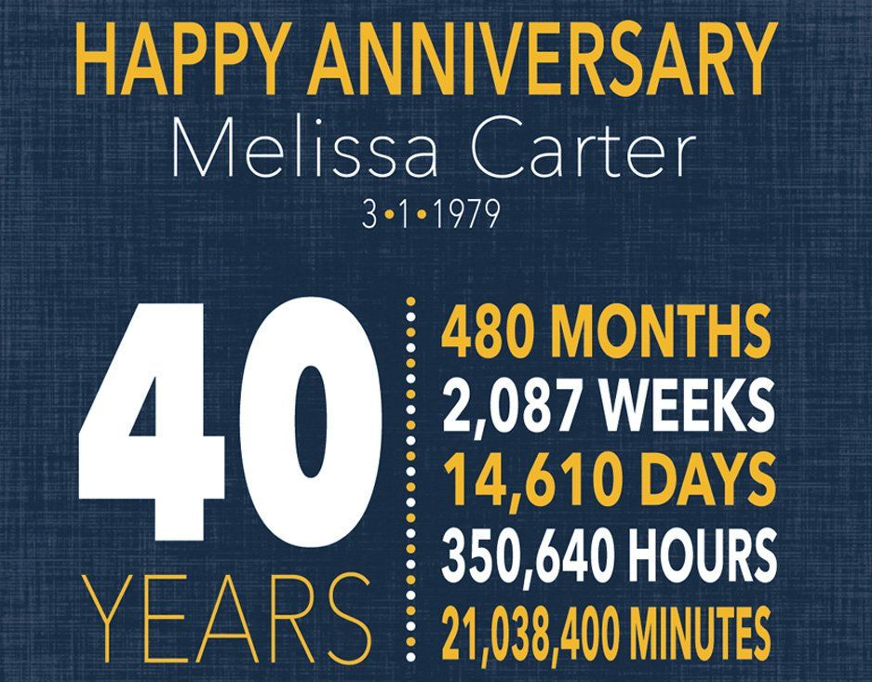






Longevity Awards
La Loma Village
Jeannette Oblea
15
180
782
5,475
131,400
7,889,238

Slide 13
Longevity Awards
Grandview Terrace
Janet Perry
20
240
1,043
7,300
175,200
10,512,000

Slide 14
Longevity Awards
Care Transitions
Shirley Burnette

